Slide 1
Lecture 35

Slide 2
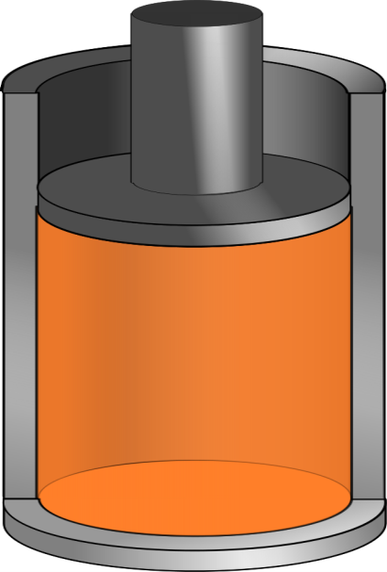

Q negative
Q positive

Slide 9
F_{p,air}
F_{p,gas}
F_{g}

Slide 11
A

Slide 12
END

Slide 13
Carnot Engine

Slide 14
A
D
B
C

Slide 15
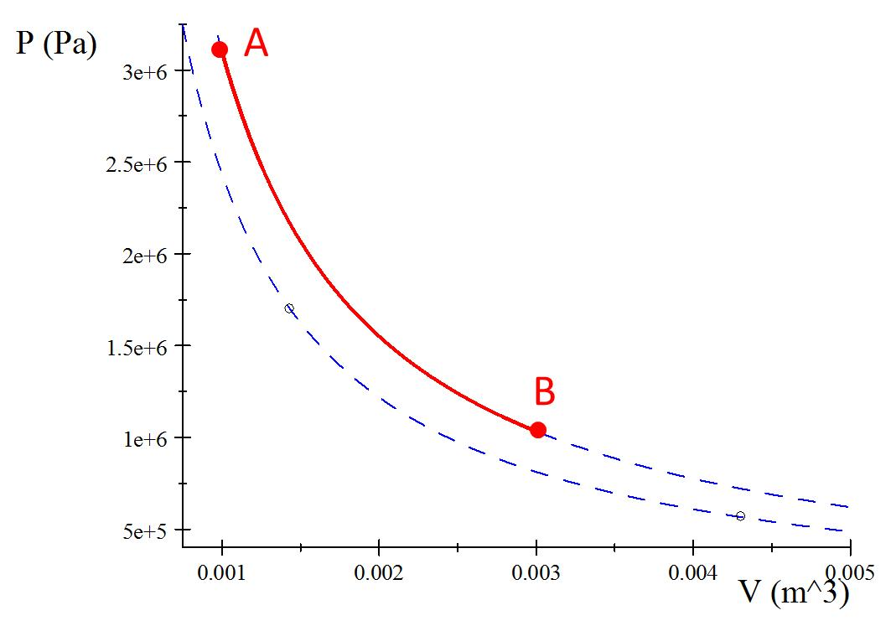

Process A to B
Q_{h}

Slide 16
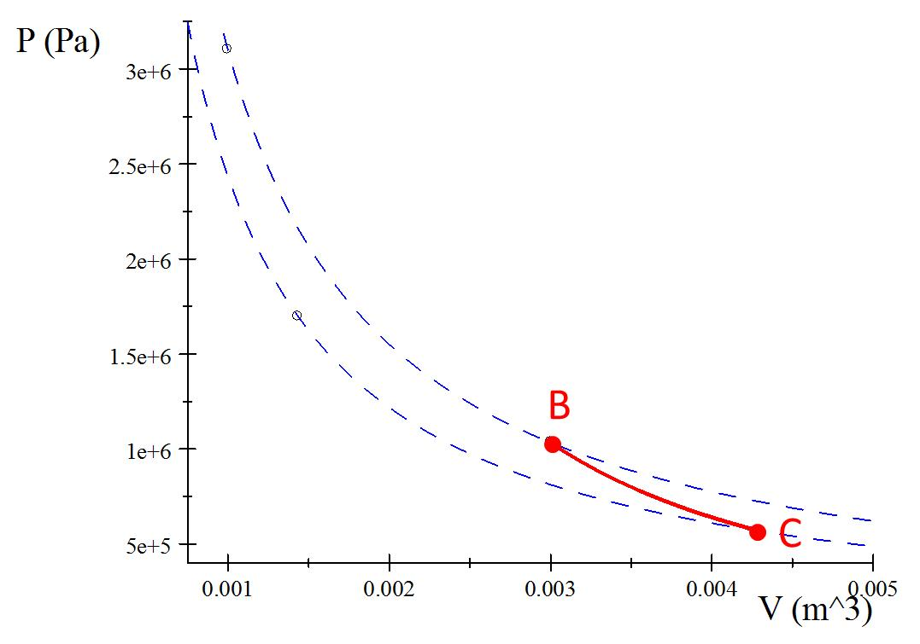
Process B to C
Insulator

Slide 17
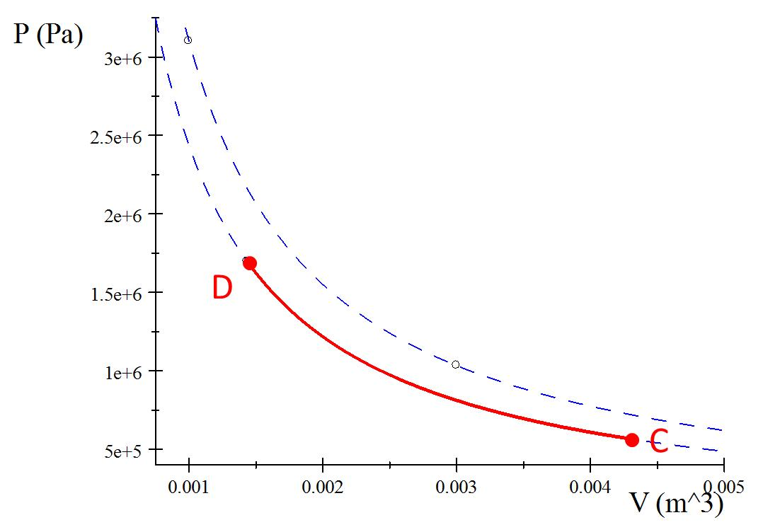
Process C to D
Q_{c}

Slide 18
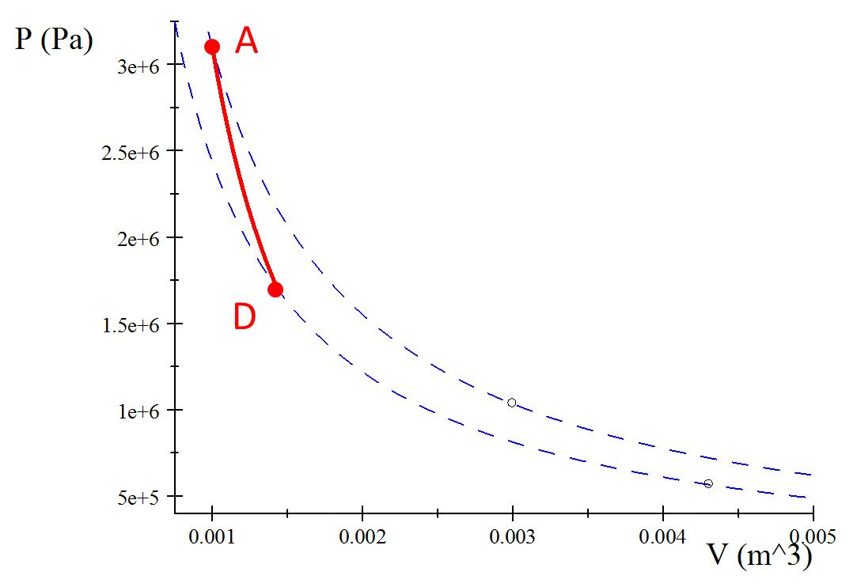
Process D to A
Insulator

Slide 19
A
B
C
D

Slide 20
Process A’B
A
B
Q_{h}

Slide 21
Process B’C
B
C
Insulator

Slide 22
Process C’D
D
C
Q_{c}

Slide 23
Process D’A
A
D
Insulator

Slide 24
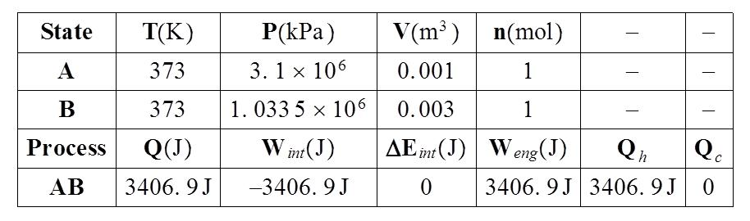

Slide 25





Identify the type of process
Write out the special equations for that process
Symbolically solve for ΔE, Q, W, P, V, and T
Identify your contribution to Q_{h} and Q_{c}
Fill in with numbers
$$V_{A}=0.001m^{3}$$
$$V_{C}=0.015m^{3}$$
$T_{A}=1023$K
$$T_{C}=293\text{K}$$
$n=$1mol

Slide 26
A
B
C
D

Slide 27
A
B
Q_{h}
Q_{c}
C
D

Slide 29


Identify the type of process
Write out the special equations for that process
Symbolically solve for ΔE, Q, W, P, V, and T
Identify your contribution to Q_{h} and Q_{c}
Fill in with numbers
$$V_{A}=0.001m^{3}$$
$$V_{C}=0.00431m^{3}$$
$T_{A}=373$K
$$T_{C}=293\text{K}$$
$n=$1mol

Slide 30
A
D
B
C

Slide 31
A
Q_{h}
D
B
Q_{c}
C

Slide 32
A
B

Slide 33
B
C

Slide 34
D
C

Slide 35
A
D

